Slide 1


NOVEMBER 2025:
Communication Styles

Slide 2
Session Overview
We see the world through our own eyes. That includes how we view people, how we communicate with people, and how we interact with the world around us.
In this session, you have an opportunity to explore how others communicate and view the world. Ideally, you can adapt your communication to meet others in a more meaningful way.

Slide 3
Have you ever…
…had a communication breakdown with a co-worker, peer or family member?
…gotten stuck in a conflict because you couldn’t bridge the gap with another person?
…been frustrated by not being understood by another person?
…struggled to understand another person’s perspective?
…felt confused by other people’s words or actions?
Learning about different communication styles may be able to help you!

Slide 4
When you…
  Understand your communication style,
  Have an idea about the communication style of those around you, and
  Know how to adapt as necessary
…you have a competitive advantage in every single interaction.
Of course – as with all things in life – this does not guarantee success, but which would you rather risk: having the information and not fully acting on it or not having the information at all?

Slide 5
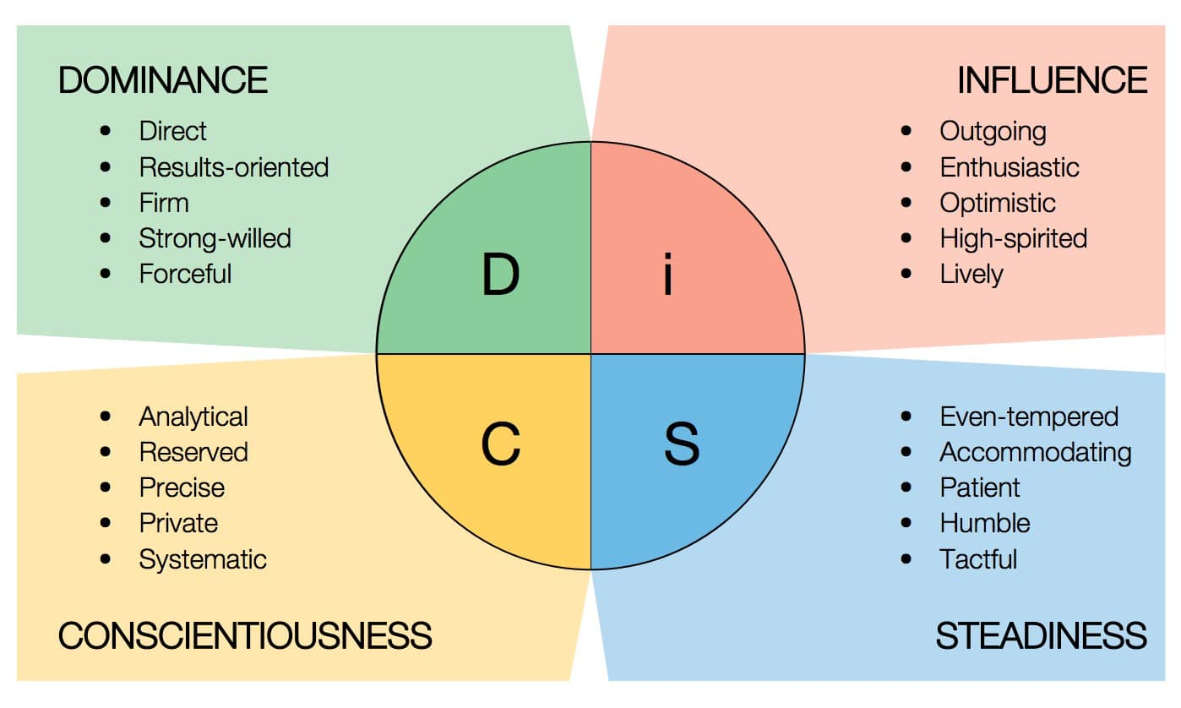
Let’s discuss our DISC Personality Test results

