Slide 1


JANUARY 2026:
Brand Building

Slide 2
Session Overview
Learn how your online presence creates a personal brand and what you can do to establish the personal brand that you want.

Slide 3

Your Professional Brand
Your professional brand is a combination of your skill set, competence, and how you are perceived.

Slide 4
Steps For Building Your Brand
Get a better understanding of how you’re perceived
Analyze that feedback in comparison with your self-image
Make a plan of action relevant to your career goals
Consider the non-verbal side of your professional brand
Be patient and compassionate on your professional branding journey
Focus on your strengths — they’ll help keep imposter syndrome at bay
Establish trust — with yourself and others

Slide 5
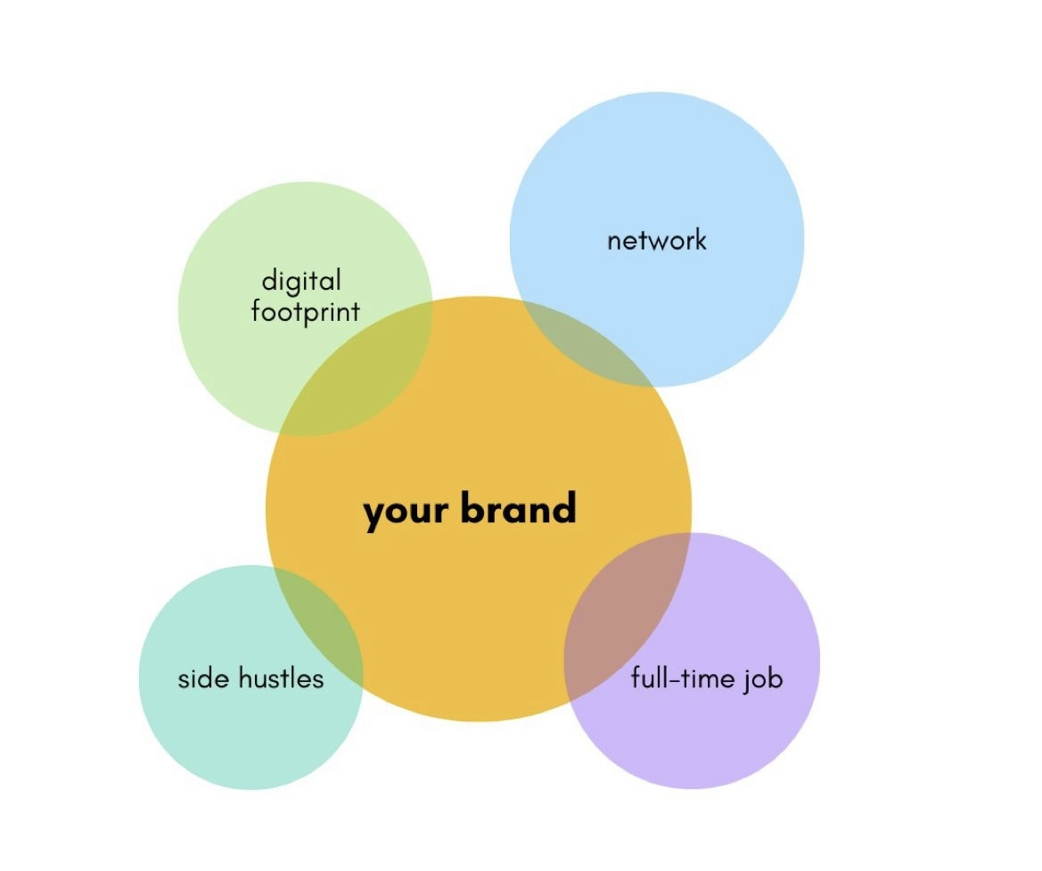
Steps For Building Your Brand - new slide

Slide 6
“As you build relationships, who you know plays an important role. Be sure to connect with others as human beings. It goes a long way in establishing or re-establishing your brand.”
- Melanie Frank, MVP, Technology

