Slide 1


FEBRUARY 2026:
Networking

Slide 2
Session Overview
Learn how networking can enhance your careers goals and get tips on how to effectively build, manage, and leverage your own personal network.

Slide 3
What is networking?
Networking isn't merely the exchange of information with others — and it's certainly not about begging for favors. Networking is about establishing, building, and nurturing long-term, mutually beneficial relationships with the people you meet, whether you're waiting to order your morning coffee, participating in an intramural sports league, or attending a work conference.

Slide 4
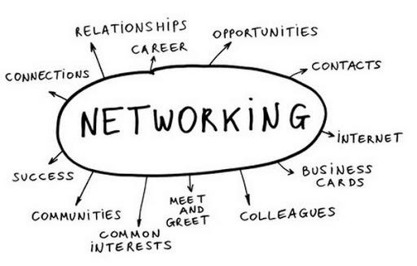
The Importance of Networking
Networking for career development
Networking in the workplace
Networking in the job search

Slide 5
Tips For Becoming An Effective Networker
Figure out what networking style works best for you
Network outside the box
Make a game plan
Follow up
Pay it forward

Slide 6
It's never too early — or too late — to invest in your network. The best way to improve your networking skills is to put yourself out there and give it a try. Possibly the worst networking mistake you can make is not trying at all.

